Slide 1

Recovery Certificate
PS-1
Board of Revenue

Slide 2
Group Members:
Shardul Tamane 2017ABPS1332H Manufacturing
Harsh Nagpal 2017AAPS1734H Electronics & Com.
Vibhor Jain 2017B3A10654P Economics and Chemical
Roshan R Nair 2017B3A31005G Economics and Electrical
Arpit Shukla 2017B3A31009G Economics and Electrical
Jai Arora 2017B1A30876H Biological Science and Electrical
Kirti Vatsal Mishra 2017B4AA0995H Mathematics and Electronics.
Sarthak Chowdhury 2017B5AA0909H Physics and Electronics.

Slide 3
1.
Board of Revenue
A brief introduction to the organisation

Slide 4
About BoR
BoR, established in Allahabad in 1831, is a government organization that deals with everything related to land purchases, sales, information etc.
The organization has a vast database, with every piece of land in Uttar Pradesh registered with a unique code.
The database includes details of
Types of soil
Crops grown in all of the three seasons
Court cases on the land (if any)
Dates of proceedings
Official map of the Land

Slide 5
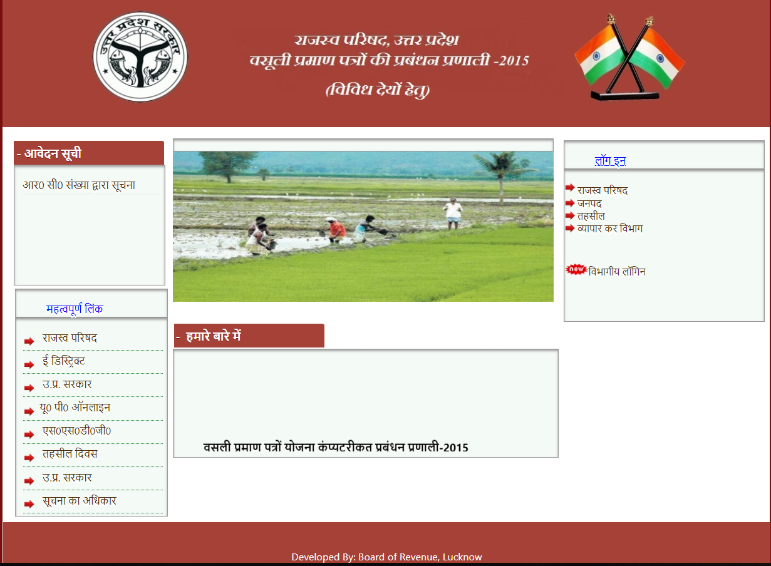

Slide 6
2.
Recovery Certificate
A brief overview of our project.

Slide 7
Recovery Certificate is an important document which is used in resolving land dispute cases.
These disputes may range from errors in land deals to loan defaults and mortgage problems.
Digitisation of land records using softwares like Java and Netbeans is also a part of this project.
The group was required to create a basic HTML form to get accustomed with the aforementioned software.

Slide 8
3.
Technical Problems & Website Functioning
An overview of the functioning of the website and the problems faced by the team.

Slide 9
Lack of a structured course material was a major hurdle.
A connection class connects the database with the required jsp files.
The connection function of this class is called in the subsequent data entry java files (OOPs Concept). A query is then generated, to retrieve data from the website and store it in the postgresql server database using the connection function.

Slide 10
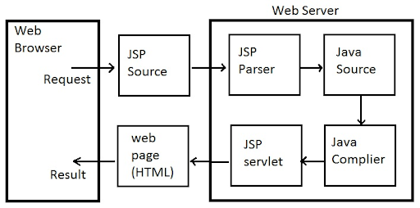

Slide 11
4.
Techniques Used:
A summary of the software used in the project

Slide 12

NetBeans:
The IDE used for the creation of the Servlet API and JSP(Java Server Pages) files which are designed to fulfill the role of a user interface for a Java web application.
Used to add Dynamic Functionality to the form.
Netbeans provides a large number of plugins for creating Java Web Applications.

Slide 13
Cascading Style Sheets:
CSS is a language for describing the presentation of Web pages.
It allows one to adapt the presentation to different types of devices.
CSS can be used with any XML - based markup language.
In our project, the XML-based markup language we are using is JSP.
We can use CSS by using it inline or inside the page or link an external CSS file to the page.

Slide 14
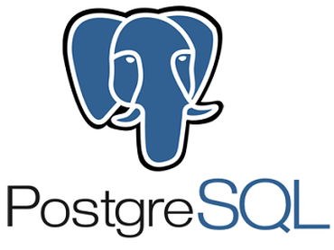
PostgreSQL:
For database management we used PostgreSql. It acts as an interface between our registration page and the database.
The programming involved to establish this connection involved four steps-
Import JDBC(Java Database Connection) Packages
Register JDBC Driver
Database URL Formulation
Create Connection Object

Slide 15

Oracle GlassFish Server:
Oracle GlassFish Server is the reference implementation of Java Enterprise Edition(Java EE).
It supports JavaServer Pages and servlets which we use in our project.
We use this over Apache Tomcat because:
it is merely a HTTP server and Java servlet container
It has a heavier memory footprint compared to Tomcat

Slide 16
5.
About the Web form
Technical details regarding the form

Slide 17
The form created includes multiple fields to enter input data like Name,ID,College name.
Options to insert a new entry or to retrieve data regarding existing entries in the database,each pointing to a different page with a different .jsp file were provided on the top right corner.
A connection class connects the database with the required .jsp files.
The connection function of this class is called in the subsequent data entry java files.(OOPs concept)

Slide 18
A query is then generated to retrieve the data from the website and store it in the PostGreSql database using connection function.
For retrieving data a similar process occurs, a generated query searches the database for the keywords provided and returns data on the user’s request.

Slide 19
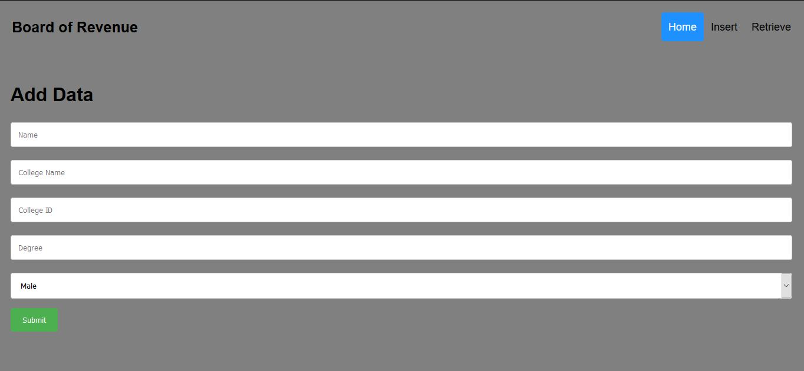
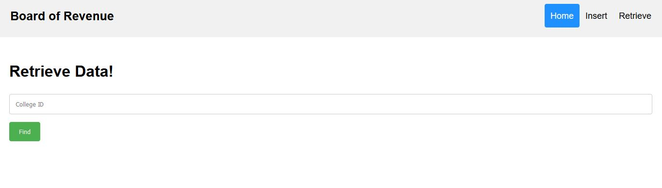

Slide 20
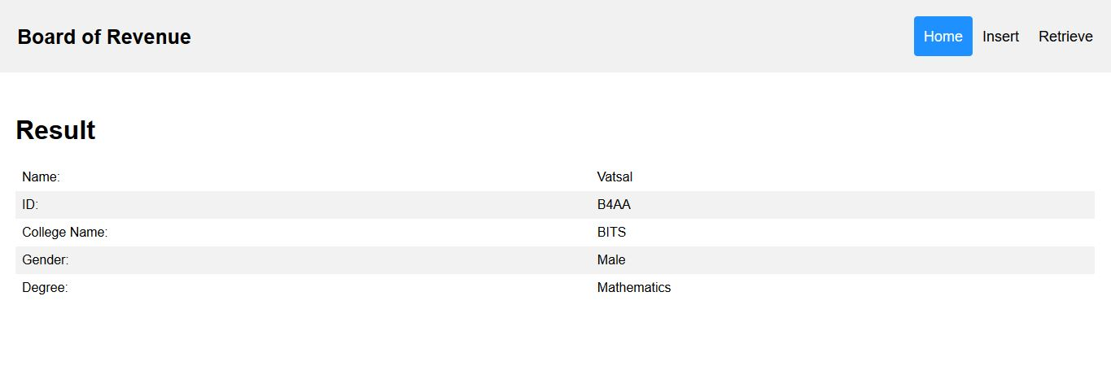

Slide 21
6.
Code Snippets

Slide 22
The dbConnection class and the connection method to connect the jsp entries to database

Slide 23
package DBMS;
import java.sql.Connection;
import java.sql.DriverManager;
import java.sql.SQLException;
// This class can be used to initialize the database connection
public class DatabaseConnection {
public static Connection initializeDatabase()
throws SQLException, ClassNotFoundException //throws error in case class not found
{
String dbDriver = "com.postgresql.jdbc.Driver"; //helps to interact with the database
String dbURL = "jdbc:postgresql:// localhost:5432/"; //connects with the local host server
String dbName = "postgres"; /* Data for the database connection */
String dbUsername = "postgres";
String dbPassword = "postgres";

Slide 24
Class.forName(dbDriver);
Connection con = DriverManager.getConnection(dbURL + dbName,
dbUsername,
dbPassword); // establishes connection
return con; //when the class function is invoked it returns the connection
}
}
Hence, this helps in establishing the connection with the database, thus forming the middle layer where the header tokens get exchanged with the said URL as in the code.

Slide 25
The “find.jsp” file
And
Its Working

Slide 26
<%@page import = "java.sql.*" %>
<% Class.forName("com.mysql.jdbc.Driver"); %>
<%@page contentType="text/html" pageEncoding="UTF-8"%>
<%!
class Database{
public String[] find(String college_id) {
String url = "jdbc:postgresql://localhost:5432/postgres"; /*provides link to the server*/
Connection con; /*invokes the connection function to the database*/
String[] result = new String[6]; /*creates String array for the respective values*/
ResultSet rs = null; /*sets default value to null */
String sqlstr1 = "select * from nameid, student_info where nameid.id = '" + college_id + "' AND student_info.id = '" + college_id + "';"; /*Query is generated for respective fields*/

Slide 27
/*try catch method is applied for exception handling*/
try {
Class.forName("org.postgresql.Driver");
}
catch(java.lang.ClassNotFoundException e) {
System.err.print("ClassNotFoundException: ");
System.err.println(e.getMessage());
}
try {
con = DriverManager.getConnection(url,"postgres", "postgres");
Statement st1 = con.createStatement();
rs = st1.executeQuery(sqlstr1);
while(rs.next()) { /*Loops through the database stored and assigns respective values*/

Slide 28
result[0] = rs.getString(1);
result[1] = rs.getString(2);
result[2] = rs.getString(3);
result[3] = rs.getString(4);
result[4] = rs.getString(5);
result[5] = rs.getString(6);
}
st1.close();
con.commit();
con.close();
return result;
}
catch(SQLException ex) { /* in case of exception error it returns null (default value) */
System.err.println("SQLException: " + ex.getMessage());
}
return result;
}
}
%>

Slide 29
The “insert.jsp” file
And
Its Working

Slide 30
<%@page import = "java.sql.*" %>
<% Class.forName("com.mysql.jdbc.Driver"); %>
<%@ taglib uri="http://java.sun.com/jsp/jstl/core" prefix="c" %>
// status message given.
<%!
class Database{
public boolean id_exists(String college_id) {
String url = "jdbc:postgresql://localhost:5432/postgres";
Connection con; // calls database connection
String sqlstr1 = "SELECT * FROM nameid WHERE id='" + college_id + "';"; //query generated
try {
Class.forName("org.postgresql.Driver");
}
catch(java.lang.ClassNotFoundException e) {
System.err.print("ClassNotFoundException: ");
System.err.println(e.getMessage());
}

Slide 31
try {
con = DriverManager.getConnection(url,"postgres", "postgres"); //passes parameters
Statement st1 = con.createStatement();
ResultSet rs = st1.executeQuery(sqlstr1);
boolean status;
if (rs.next())
status = true;
else
status = false;
st1.close();
con.commit();
con.close();
return status;
}
catch (SQLIntegrityConstraintViolationException ex) {
return false;
}
catch(SQLException ex) {
System.err.println("SQLException: " + ex.getMessage());
return false;
}
}

Slide 32
public boolean insert_name(String name, String college_id) {
String url = "jdbc:postgresql://localhost:5432/postgres";
Connection con;
String sqlstr1 = "insert into nameid VALUES('" + name + "', '" + college_id + "');";
try {
Class.forName("org.postgresql.Driver");
}
catch(java.lang.ClassNotFoundException e) {
System.err.print("ClassNotFoundException: ");
System.err.println(e.getMessage());
}
try {
con = DriverManager.getConnection(url,"postgres", "postgres");// Calls dbConnection class
Statement st1 = con.createStatement();
st1.executeQuery(sqlstr1);
st1.close();
con.commit();
con.close(); }
catch (SQLIntegrityConstraintViolationException ex) {
return false; }

Slide 33
catch(SQLException ex) {
System.err.println("SQLException: " + ex.getMessage());//Displays SQL Exception
return true;
}
return true;
}
public boolean insert_info(String college_id, String college_name, String gender, String degree) {
String url = "jdbc:postgresql://localhost:5432/postgres";
Connection con;
String sqlstr2 = "insert into student_info VALUES('" + college_id + "', '" + gender + "', '" + college_name + "', '" + degree + "');";
try {
Class.forName("org.postgresql.Driver");
}
catch(java.lang.ClassNotFoundException e) {
System.err.print("ClassNotFoundException: ");
System.err.println(e.getMessage());
}

Slide 34
try {
con = DriverManager.getConnection(url,"postgres", "postgres");
Statement st1 = con.createStatement();
st1.executeQuery(sqlstr2);
st1.close();
con.close();
}
catch(SQLException ex) {
System.err.println("SQLException: " + ex.getMessage());
return false;
}
return true;
}
}
%>

Slide 35
The INDEX page
and
The front-end involved

Slide 36
<%@page contentType="text/html" pageEncoding="UTF-8"%>
<!DOCTYPE html>
<link rel="stylesheet" type="text/css" href="style.css">
<div class="header">
<a href="index.jsp" class="logo">Board of Revenue</a>
<div class="header-right">
<a class="active" href="index.jsp">Home</a>
<a href="add.jsp">Insert</a>
<a href="retrieve.jsp">Retrieve</a>
</div>
</div>
<html>
<head>
<meta http-equiv="Content-Type" content="text/html; charset=UTF-8">
<title>Welcome Page</title>
</head>
<body>
<div style="padding:20px;margin-top:100px;">
<h1>Information Portal:</h1>
<ul>
<li> <a href ="add.jsp"> Add New Entry! </a> </li>
<li> <a href ="retrieve.jsp"> Retrieve Previous Entries! </a> </li>
</ul>
</div>
</body>
</html>

Slide 37
7.
Final Steps
Our plans for the future

Slide 38
Creation of several web pages and a navigation menu which will contain links to other webpage and forms.
Webpages are required to be styled using CSS.
Creation of more web forms using Java backend and HTML CSS frontend.
Linking these forms with the database on Sql.
The constructed web pages and webforms should be able to cater to the needs of the organisation.

Slide 39
8.
Conclusion
Some concluding words...

Slide 40
The Recovery Certificate required the group to coordinate together as a team.
The project required learning new software which consequently improved our technical knowledge.
Creation of a university portal required a sound knowledge of Netbeans and PostGreSql.
The Group also got familiar with the jargons associated with land records.
We aim to contribute even more to this project and help in the digitisation of the land records.

Slide 41
THANK YOU!

